Slide 1
Addition Reaction

Slide 2
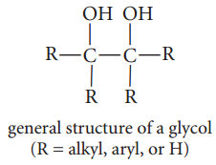
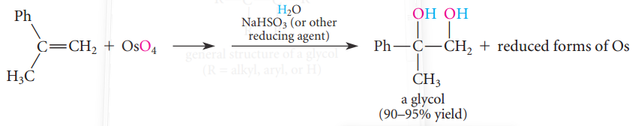
PREPARATION AND OXIDATIVE CLEAVAGE OF GLYCOLS
Glycols are compounds that contain hydroxy groups on adjacent carbon atoms.
A. Preparation of Glycols
You have already learned that some glycols can be prepared by the acid-catalyzed reaction of water with epoxides
The other important method for the preparation of glycols is the oxidation of alkenes with OsO4.

Slide 3
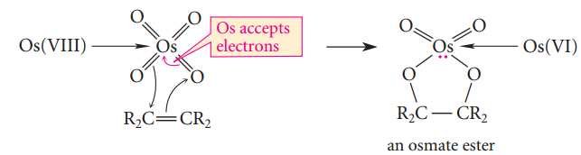
Cont’d
The osmium in OsO4 is in a +8 oxidation state. Metals in high oxidation states (such as Mn(VII) and Cr(VI), as you’ve learned) are oxidizing agents because they attract electrons. This electron-attracting ability of Os(VIII) results in a concerted (that is, one-step) cycloaddition reaction between OsO4 and an alkene to give an intermediate called an osmate ester:
A glycol is formed when the cyclic osmate ester is treated with water. Two water molecules, acting as nucleophiles, displace the glycol oxygens from the osmium. A mild reducing agent such as sodium bisulfite, NaHSO3, is often added to convert the osmium-containing byproducts into reduced forms of osmium that are easy to remove by filtration. (The NaHSO3 is converted into sodium sulfate, Na2SO4.)

Slide 4
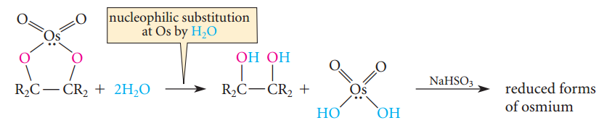
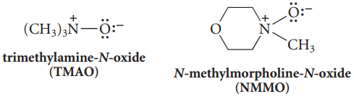
Cont’d
Sdd
Two practical drawbacks to the use of the OsO4 oxidation are that osmium and its compounds are very toxic, and they are quite expensive.
To solve this problems chemists devise the way to use small amount of OsO4 with some oxidant that “recycles” the Os(VI) by-product back into OsO4. Among the common oxidants used for this purpose are amine oxides, which are compounds of the form R3N+O-. Two amine oxides used commonly are the following:

Slide 5
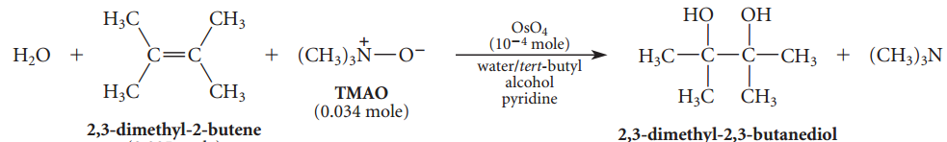
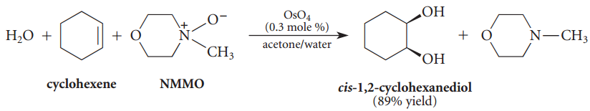
Cont’d
In other words, once a small amount of OsO4 is used up, the Os(VI) by-product is oxidized within the reaction mixture by the amine oxide to re-form OsO4. Thus, a catalytic amount of OsO4 can be used and the amine oxide acts as the ultimate oxidant.
The formation of glycols from alkenes is a stereospecific syn-addition.

Slide 6
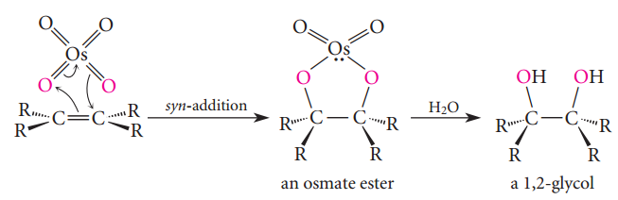
Cont’d
Hydrolysis of the osmate ester gives the glycol.
On the other hand, an anti-addition by a concerted mechanism would be very difficult, if not impossible: the two reacting oxygens of OsO4 cannot simultaneously reach opposite faces of the pi bond.
The hydrolysis of epoxides and the OsO4 oxidation are complementary reactions becausethey provide glycols of different stereochemistry. Exercise Outline preparations of cis-1,2-cyclohexanediol and (+)-trans-1,2-cyclohexanediol from cyclohexene.

Slide 7
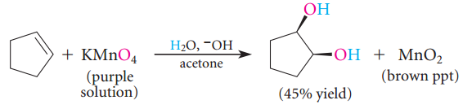
Cont’d
Glycol formation from alkenes can also be carried out with potassium permanganate (KMnO4), usually under aqueous alkaline conditions. This reaction is also a stereospecific syn-addition, and its mechanism is probably similar to that of OsO4 addition.
Although the use of KMnO4 avoids the expense of OsO4, a problem with the use of KMnO4 is that yields are low in many cases because over-oxidation occurs; that is, the glycol product is oxidized further. The manganese in MnO4- is in the +7 oxidation state. It is converted into Mn(IV) as a result of the reaction. Visually, when oxidation occurs, the brilliant purple color of the permanganateion is replaced by a murky brown precipitate of manganese dioxide (MnO2). This color change can be used as a test for functional groups that can be oxidized by KMnO4.

Slide 8

Cont’d
Exercise
1. What organic product is formed (including its stereochemistry) when each of the following alkenes is treated with NMMO in the presence of H2O and a catalytic amount of OsO4? (a) 1-methylcyclopentene (b) trans-2-butene 2. From what alkene could each of the following glycols be prepared by the OsO4 or KMnO4 method?

Slide 9
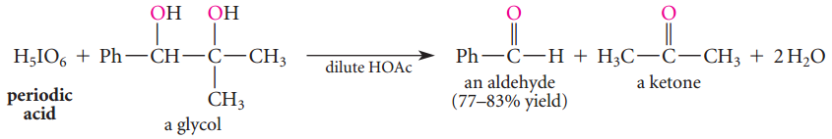


B. Oxidative Cleavage of Glycols
The carbon–carbon bond between the -OH groups of a glycol can be cleaved with periodic acid to give two carbonyl compounds:
Periodic acid (pronounced PURR-eye-OH-dik) is the iodine analog of perchloric acid.

Slide 10
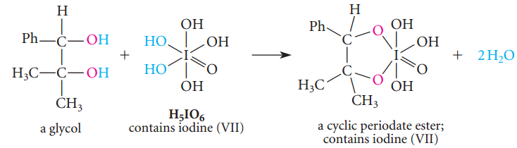
Cont’d
Periodic acid is commercially available as the dihydrate, HIO4.2H2O, often abbreviated in the above example (sometimes called para-periodic acid). Its sodium salt, NaIO4 (sodium metaperiodate), is sometimes also used. Periodic acid is a fairly strong acid (pKa = -1.6). The periodate cleavage reaction has been used as a test for glycols as well as for synthesis. The formulas HIO4 or H5IO6 are used interchangeably for periodic acid. The cleavage of glycols with periodic acid takes place through a cyclic periodate ester intermediate (Sec. 10.3C) that forms when the glycol displaces two LOH groups from H5IO6.

Slide 11
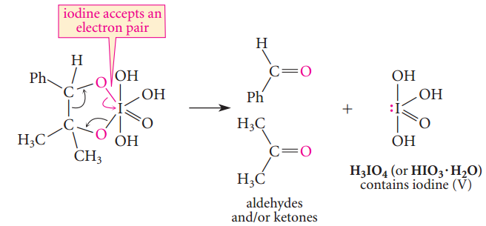
Cont’d
The cyclic ester spontaneously breaks down by a cyclic flow of electrons in which the iodine accepts an electron pair. (The direction of electron flow is arbitrary.)
A glycol that cannot form a cyclic ester intermediate is not cleaved by periodic acid. For example, the following compound is not cleaved because it is impossible for both oxygens to be part of the same cyclic periodate ester.

Slide 12
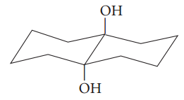
Cont’d
See the example below
Do not confuse osmium tetroxide, permanganate, and periodate oxidations, all of which occur through cyclic ester intermediates. Periodate oxidizes glycols, but the other two reagents oxidize alkenes to give glycols.
In all of these reactions, oxidation occurs because an atom in a highly positive oxidation state can accept an additional pair of electrons.
In the periodate oxidation, the reduction of the iodine occurs during the breakdown of a cyclic ester; in the permanganate and osmium tetroxide oxidations, the metals are reduced during the formation of a cyclic ester.

Slide 13

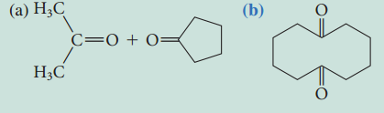
Cont’d
Exercise
1. Give the product(s) expected when each of the following compounds is treated with periodic acid.
2. What glycol undergoes oxidation to give each of the following sets of products?

Slide 14
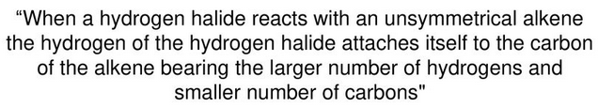
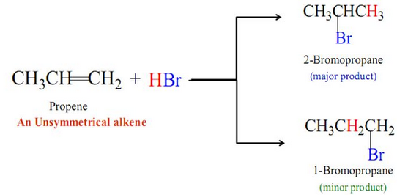
Markovnikov’s Rule
D

Slide 15
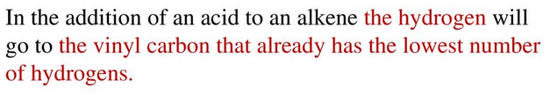
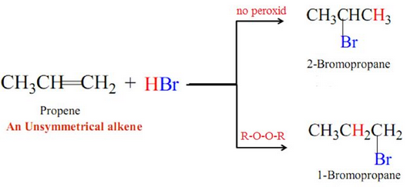
Anti-Markovnikov’s Rule
B

Slide 16

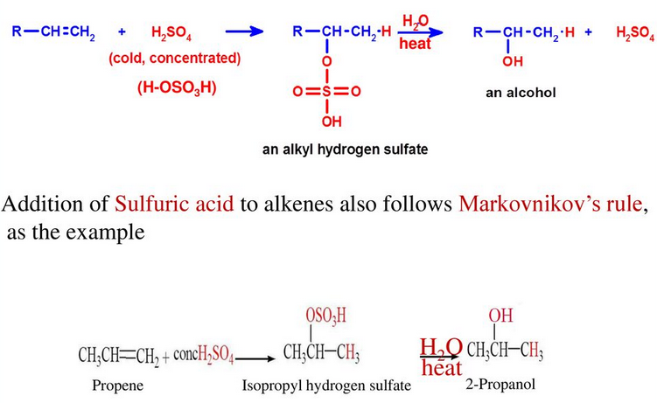
.

Slide 17
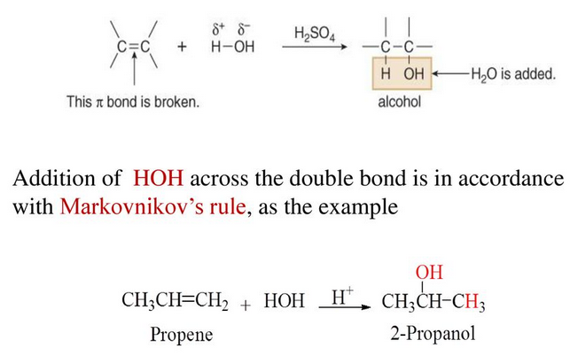
.

Slide 18
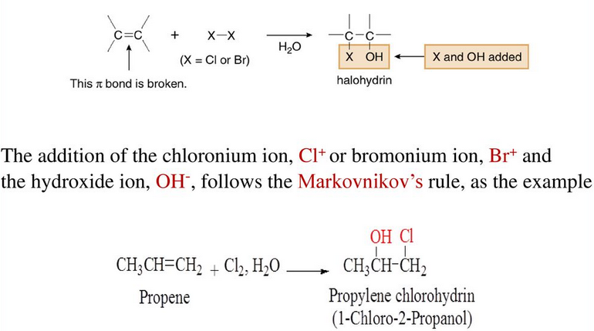
.

Slide 19

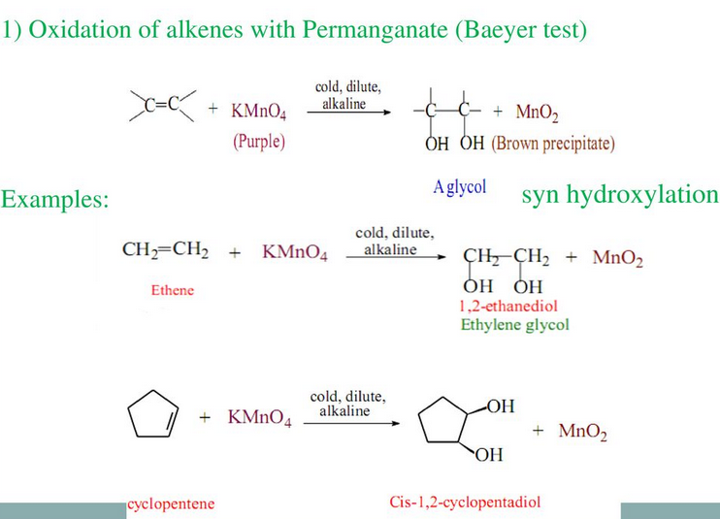
.

Slide 20
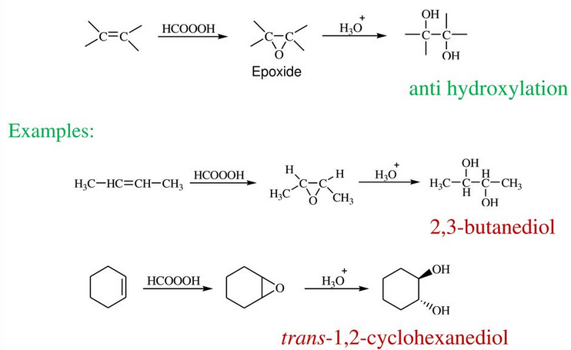
.

Slide 21
.

